Slide 1
Assembly Language
Lab 2
2022/09/26

Slide 2
Objectives
Complete the following code
Calculate the value of Rval = -(Val3 – 14 * (Val1 ＋ Val2))
and store it in Rval
The code must be written one by one according to the formula, and it is not allowed to simplify and then write the code without authorization
.data
Value1 SBYTE 03h
Value2 SBYTE 02h
Value3 SBYTE 8fh
Result SDWORD ?
.code
main PROC
; Please Write your code here.
exit
main ENDP
END main
Notes:
Lab2的主要目的是讓同學學會對暫存器中的數值進行運算

Slide 3
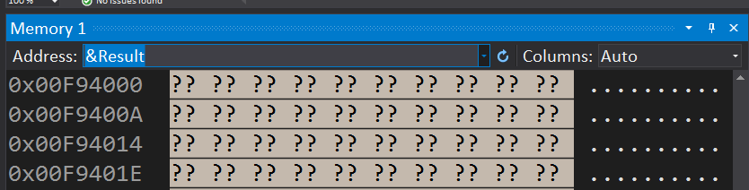
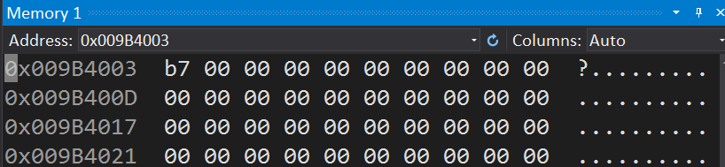
Program Result Debug -> Windows -> Memory Type "&" in the Memory window and add the name of the variable you want to see

Slide 4
Common Mistakes
SIZE of the operand must be the same
Structure changing of the program (ex: delete to exit...)

Slide 5
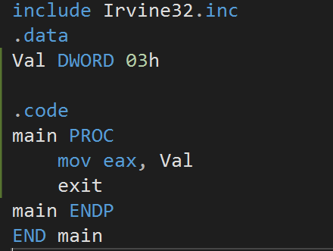
1. SIZE of the operand must be the same

Slide 6
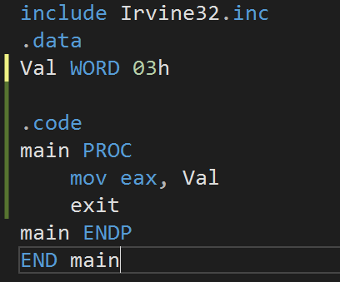
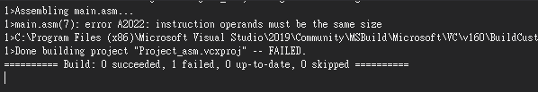
Possible Error Msg (1)

Slide 7
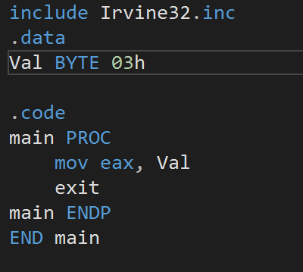
Possible Error Msg (2)

Slide 8
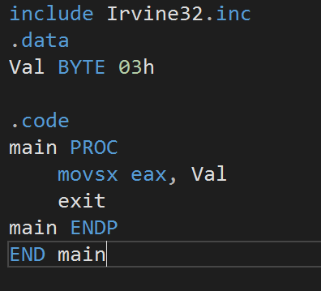
Solutions

Slide 9
Report
Due to tomorrow (2022/09/27)
Before 12:00
If you submit late, please send a letter to the teaching assistant, points will be deducted
Group Task
Compress(.zip,.rar) the following file with the name of the group ( e.g. lab2_01.zip)
Code(lab2_01.asm)
Report(lab2_01.doc or lab2_01.pdf)
Report Title
Group, name, student ID
Step by step of program execution flow, memory (register) status
Screenshots description, code Description
Reviews for the class, lesson learned, the tools we used, TA, etc

Slide 10
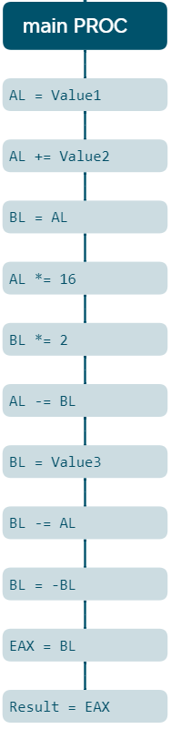











Command
Register
Insert Value1 to the register “al”
Adding Value2 to the register ”al”
Saving “al” saved value to register “bl”
Multiplying the register “AL” by 2^4
Multiplying the register “BL” by 2^1
Subtracting “BL” register value to “AL”
Inserting Value3 to the register “BL”
Subtracting “AL” register value to “BL”
Negating BL value
Inserting “BL” value to EAX register
Inserting EAX to Result
Result memory only changes after the final step. (line 20)

